Slide 1
Muralikrishnan Subbaian
Data Ingestion Framework
BIS Academy

Slide 2
AGENDA
Data Ingestion Overview
File Copy
Operation Dash Board
DB Copy

Slide 3
Data Ingestion Overview
Data ingestion framework is a UI based application that can used to create the copy job for different source type. This will generate the workflow and shell script which can be scheduled in Tidal for periodical execution. The job will copy the file into target location after cleaning and validating. This will create a external hive table on top of the copied file
File copy
Create configuration
Edit Configuration
Generate & Execute generated Script
Operation Dash Board
Show hourly operational details
Oozie dash board
DB Copy
Create configuration
Edit Configuration
Generate & Execute generated Script

Slide 4
File Copy
Saving the meta data for a file copy job
Generate the execution scripts for the job that will be scheduled in Tidal
Create the hive table for that job
Capturing the hive table definition in meta store
Edit the configured job
Job execution
Copy the file/files into raw file location from the source location
Clean the file with pre define cleansing routine and copy the cleaned file into final destination
Create daily hive partition on final output location
Regular expression in raw file format
Logging the details in Hbase table for operational Dash Board
Re submit the failed and partial failed job

Slide 5
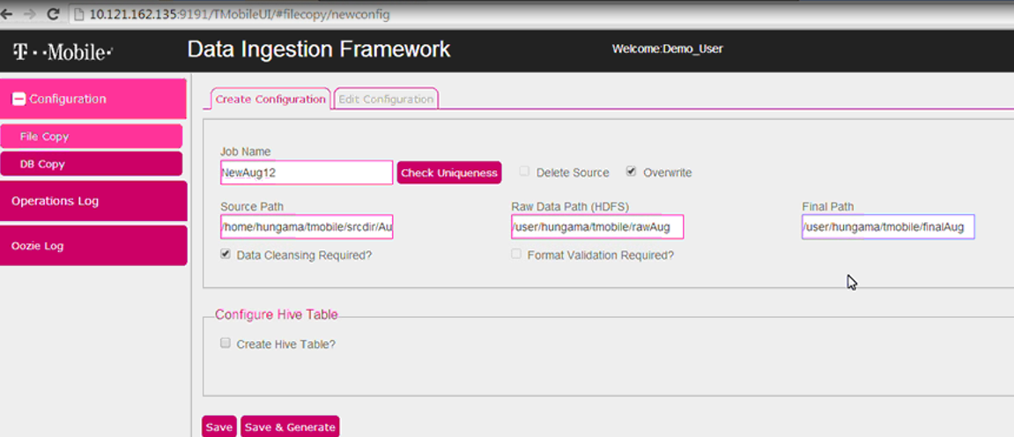
File Copy
File Copy configuration details are entered in the below screen

Slide 6
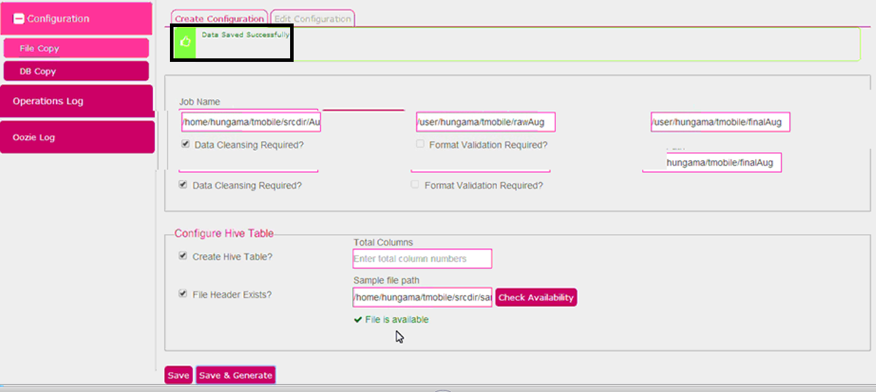
File Copy
File Copy configuration details saved successfully

Slide 7
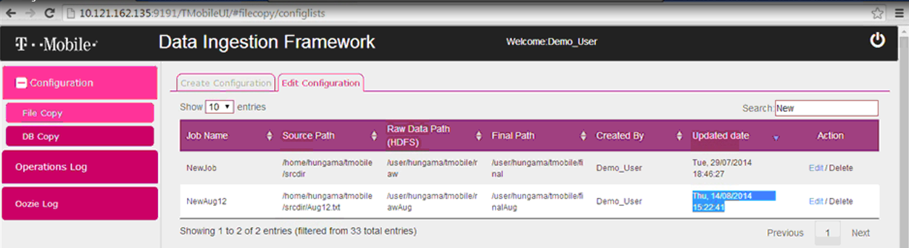
File Copy
Edit configuration tab shows the Job name NewAug12 is created with source path , raw data path (HDFS ) and Final path (HDFS – Hive tables)

Slide 8
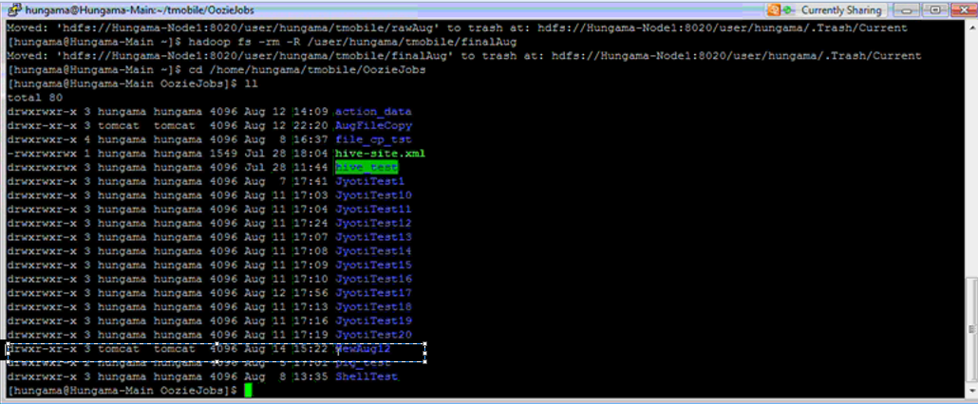
File Copy
When you choose Save & Generated option, the required jobs are created under the folder /home/hungama/tmobile/OozieJobs. This path is configurable in the ingestion frame work property file. You can observe NewAug12 directory is present in the name of the Job name below:

Slide 9
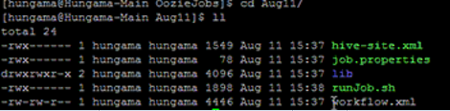
File Copy
Below are the list of job created for the Job name NewAug11. Lib file contains all the jar files required for execution. runJob.sh will be scheduled to run will call the workflow.xml that has the activities to be performed. Workflow.xml will take inputs from the job.properties file and hive-site.xml file

Slide 10
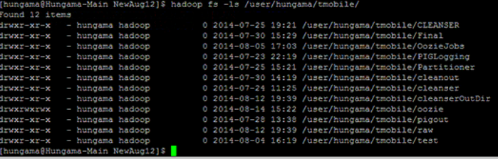
File Copy
You can see under /user/hungama/tmobile there are no folder names called rawAug or finalAug

Slide 11
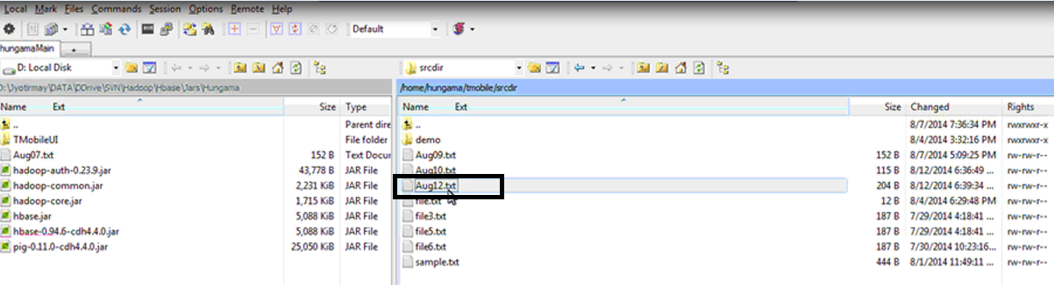
File Copy
You can view the content of the source file that has spaces and tab in between

Slide 12
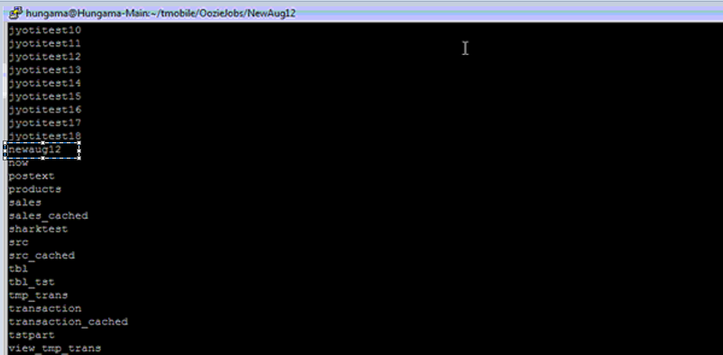
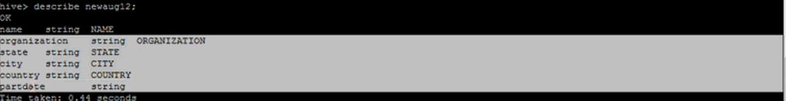
File Copy
In external hive directory we can see newaug12 table is created and table structure is shown below and there is no data in it since we have not yet run the job.

Slide 13
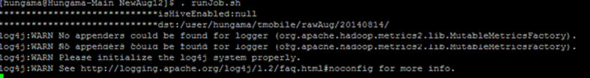
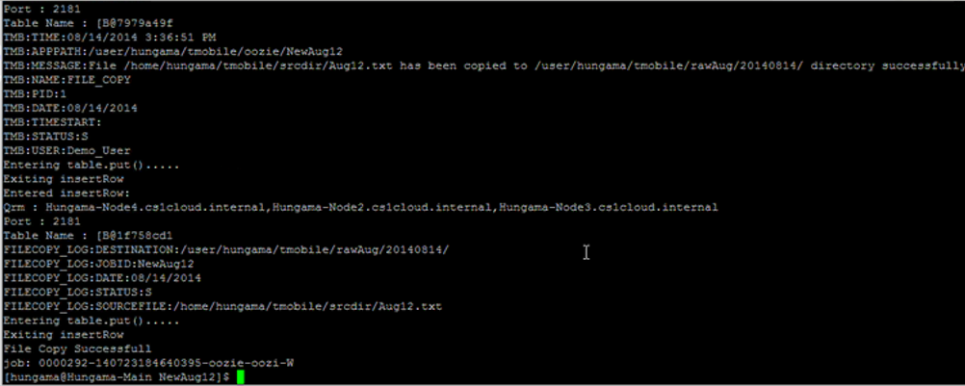
File Copy
Run the job now

Slide 14
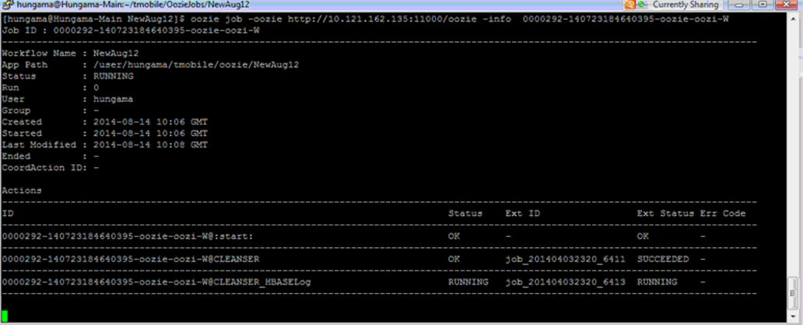
File Copy
Cleansing part is completed and cleansing log being written to Hbase log file

Slide 15
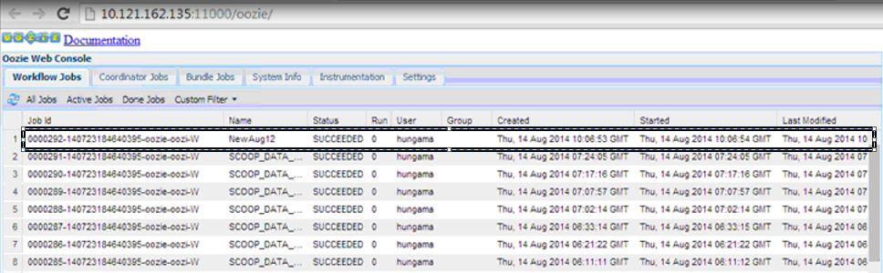
File Copy
Also you can look at the job status directly in the oozie log as below
When the job is running first the cleansing process will taking place that will remove spaces and tabs or any special characters. Then log of the cleansing process will be written to the Hbase log file. Hive partition will be created day wise so we can get the delta data and log will be written to hbase log file. If any error, mail will be process will come to an end.
End

Slide 16
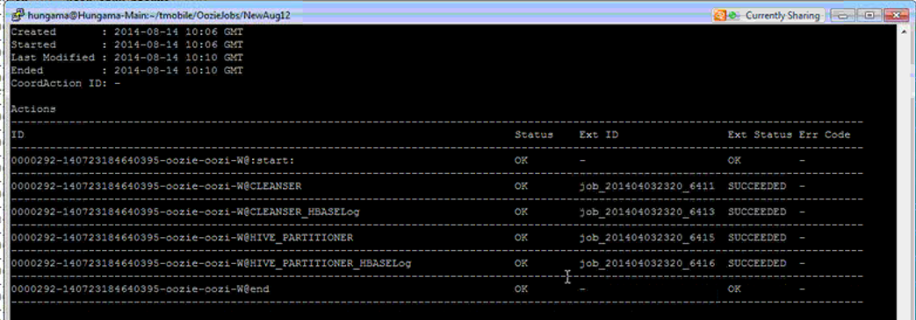
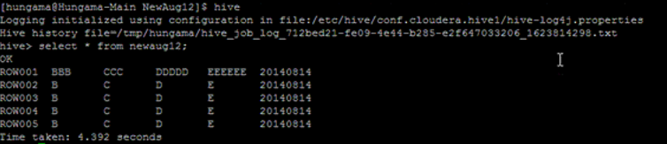
File Copy
All jobs completed are successfully and you able to see the data in Hive

Slide 17
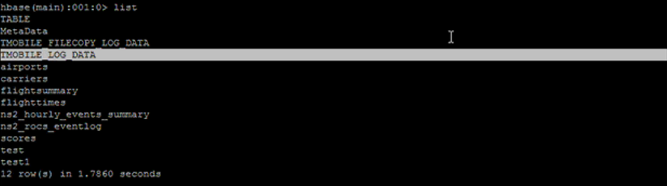
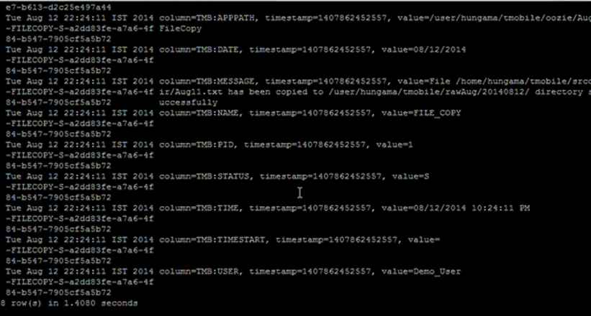
File Copy
All jobs completed successfully and Hbase log file is shown below

Slide 18
File Copy – Additional points
When Hive table is created, if you not sure of the column name, you can mention the number of columns to be created in the Hive table. The script will create columns in Hive table with column names like column-1, column-2……
The File Copy can also bring in unstructured data into HDFS, in those case you don’t have to select ‘Create Hive Table’ option and pig tool can be used to analyze the data.
Once you select Save, the configuration data is stored in the mysql database. When you choose Save & Generate, it will additionally create script job that will be scheduled in the scheduler. Also hive table is created at this point of time
Final path is the Hive target path

Slide 19
Operation Dash Board
Daily Summary report
Drill down to Hourly Operation log
Oozie Execution view integrated with the Dash Board
Oozie Job log integrated with the Dash Board

Slide 20
DB Copy
DB Copy follows the same method as of File Copy.
Saving the configuration data for a db copy job
User interface will fetch the table meta data information from the source data base.
Generate the execution scripts for the job that will be scheduled in Tidal
Create the hive table for that job
Capturing the hive table definition in meta store
Edit the configured job
Job execution
Export table data into raw file location
Clean the exported file with pre define cleansing routine and copy the cleaned file into final destination
Create hive partition on final output location
Logging the details in Hbase table for operational Dash Board
Re submit the failed and partial failed job

Slide 21
Thank You

